Slide 1
1- IBFE: Getting Started
Adapted from Alex Hoover’s tutorial

Slide 2
Important links
Original Paper: http://www.math.nyu.edu/phd_students/griffith/docs/griffith_luo_ibfem.pdf
Libmesh documentation:
http://libmesh.sourceforge.net/doxygen/index.php
Libmesh function for reading in meshes:
http://libmesh.sourceforge.net/doxygen/classlibMesh_1_1MeshInput.php
Libmesh utilities for handling tensors:
http://libmesh.sourceforge.net/doxygen/classlibMesh_1_1TensorValue.php
IBAMR’s Libmesh functions:
https://code.google.com/p/ibamr/source/browse/branches/boyceg/ibtk/src/utilities/libmesh_utilities.h?spec=svn2564&r=2564

Slide 3
What will you need?
A mesh
For simple objects, you can generate it within main.C (Triangle)
Create it externally (Tetgen, Matlab, gmsh, Trellis, Bolt) and read it in your main.C
There are many other options (look at the libmesh MeshInput link)
A material model to apply stress/forces
First Piola-Kirchhoff Stress Tensor (PK1)
Body Force
Surface Force
For review of solid mechanics, see
http://homepages.engineering.auckland.ac.nz/~pkel015/SolidMechanicsBooks/Part_III/
For PK1, see 3.5 Stress Measures for Large Deformations

Slide 4
Tether Force/Target Point Example
2D Rectangular Mesh
Reads the Matlab file “IBFE_Mesh2D_128.mat”, which is a mesh file generated using Matlab
Old: Mesh discretizing edge length is ds = 2*dx (as opposed to ½*dx)
New: it seems like ds = dx works better
TRI3 elements (triangular element with 3 nodes)
Material Model (in the ModelData namespace, not the main routine)
Neo-Hookean Model - think springs
Body Force/Tether Force that move the plate up and down (think target points)

Slide 5
Input2D - IBFE specific lines
Approximate density of quadrature points for the Lagrangian-Eulerian Interaction (IBFE uses these instead of nodes to prevent leaking)
IB_POINT_DENSITY = 2.0 //It seems like 1.0 is better
Ratio of Lagrangian mesh width to Cartesian mesh width
MFAC = 2.0 // It seems like 1.0 is better
Type of element to use for structure discretization
ELEM_TYPE = "TRI3" //modify if using tet, hex
Quadrature order for our PK1 stress
PK1_DEV_QUAD_ORDER = "FIFTH"
PK1_DIL_QUAD_ORDER = "THIRD"
Additional string for ExodusII file type
viz_writer = "VisIt","ExodusII"
viz_dump_interval = 100
viz_dump_dirname = "viz_IB2d"
visit_number_procs_per_file = 1

Slide 6
Makefile flags
At the beginning of the Makefile declare LIBSNEW
LIBSNEW = $(LIBS) -lnetcdf -lcurl
IBAMR_SRC_DIR = /nas/longleaf/apps-dogwood/ibamr/2018-03/sfw/ibamr/IBAMR
IBAMR_BUILD_DIR =/nas/longleaf/apps-dogwood/ibamr/2018-03/sfw/ibamr/ibamr-objs-opt

Slide 7
Example_IBFE_TetherForceFullPlate2D
Look in the main.C file.
The basic idea is to use a tether force defined in the ModelData namespace. This appears near the top of the main.C file.
Goal: have a plate move up to .5 (in 1 s) then down 1.0 (in 2s), after which the force is turned off (for 1 s).
This is similar to target points, but you’re using the reference configuration as a reference point to move each element. This is explained more on the next slide.

Slide 8
Reference configuration
Below is an example of moving the beam.
(s(0), s(1)) are the (x,y) coordinates of the initial mesh.
(s_dump(0), s_dump(1)) are the (x,y) coordinates of where you currently want the target points to be.
So let’s say you want to translate the boundary up at velocity V = 0.5, then the lines of code below do this.
//only change the y-coordinate.
s_dump(1)=s(1)+.5*time; // s(1) is the x-coordinate of the reference configuration.
s_dump(0)=s(0); //s(0) is the x-coordinate of the reference configuration

Slide 9
Reference configuration
Let’s say you want to translate the boundary to the left at velocity V = 0.3, then the lines of code below do this.
//only change the x-coordinate.
s_dump(1)=s(1); //s(1) is the y-coordinate of the reference configuration.
s_dump(0)=s(0)-0.3*time; //s(0) is the x-coordinate of the reference configuration

Slide 10
Target force function at top of main.C
namespace ModelData
{
// Problem parameters.
static const double mu = 10.0; //Elastic modulus of the beam
static double kappa_s = 1.0e6; // body force spring constant for applying a tether force
target_force_function( VectorValue<double>& F,
const TensorValue<double>& /*FF*/,
const libMesh::Point& X,
const libMesh::Point& s,
Elem* const /*elem*/,
const std::vector<const std::vector<double>*>& /*var_data*/,
const std::vector<const std::vector<VectorValue<double> >*>& /*grad_var_data*/,
double time,
void* /*ctx*/){

Slide 11
Code to move plate with target force
libMesh::Point s_dump; //s_dump is the target point position
if(time<1) //This will move the beam up with a speed of 0.5 from 0<t<1
{
s_dump(1)=s(1)+.5*time; //only change the y-coordinate. s(1) is the x-coordinate of the reference configuration.
s_dump(0)=s(0); //s(0) is the x-coordinate of the reference configuration
}
else if(time<3) //This will move the beam down with a speed of -0.5 for 1<t<3
{
s_dump(1)=s(1)+.5+.5*(1-time);
s_dump(0)=s(0);
}
else //set the target point location to the actual location of the boundary (X) to make force equal to zero.
{
s_dump(1)=X(1);
s_dump(0)=X(0);
}
F = kappa_s*(s_dump-X); //apply a target force equal to kappa_s times the difference between tether and actual positions.
return;
}

Slide 12
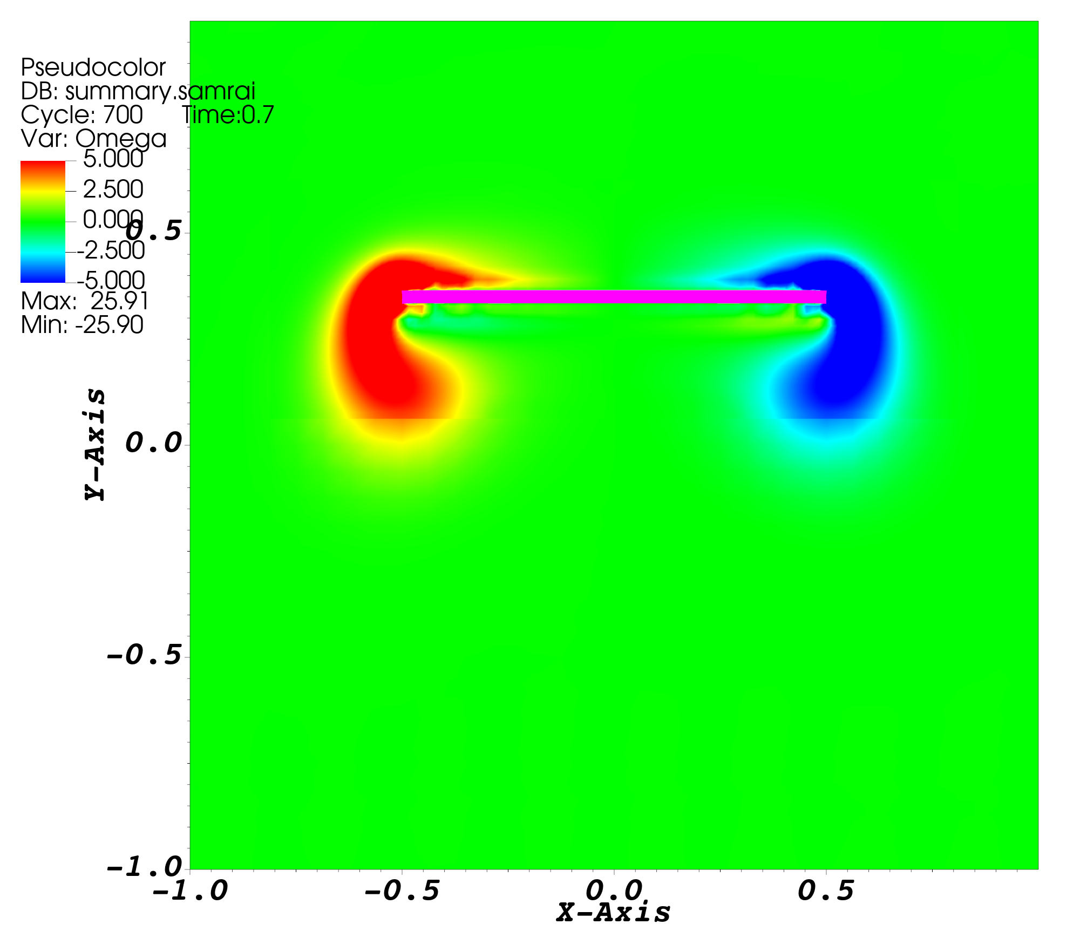
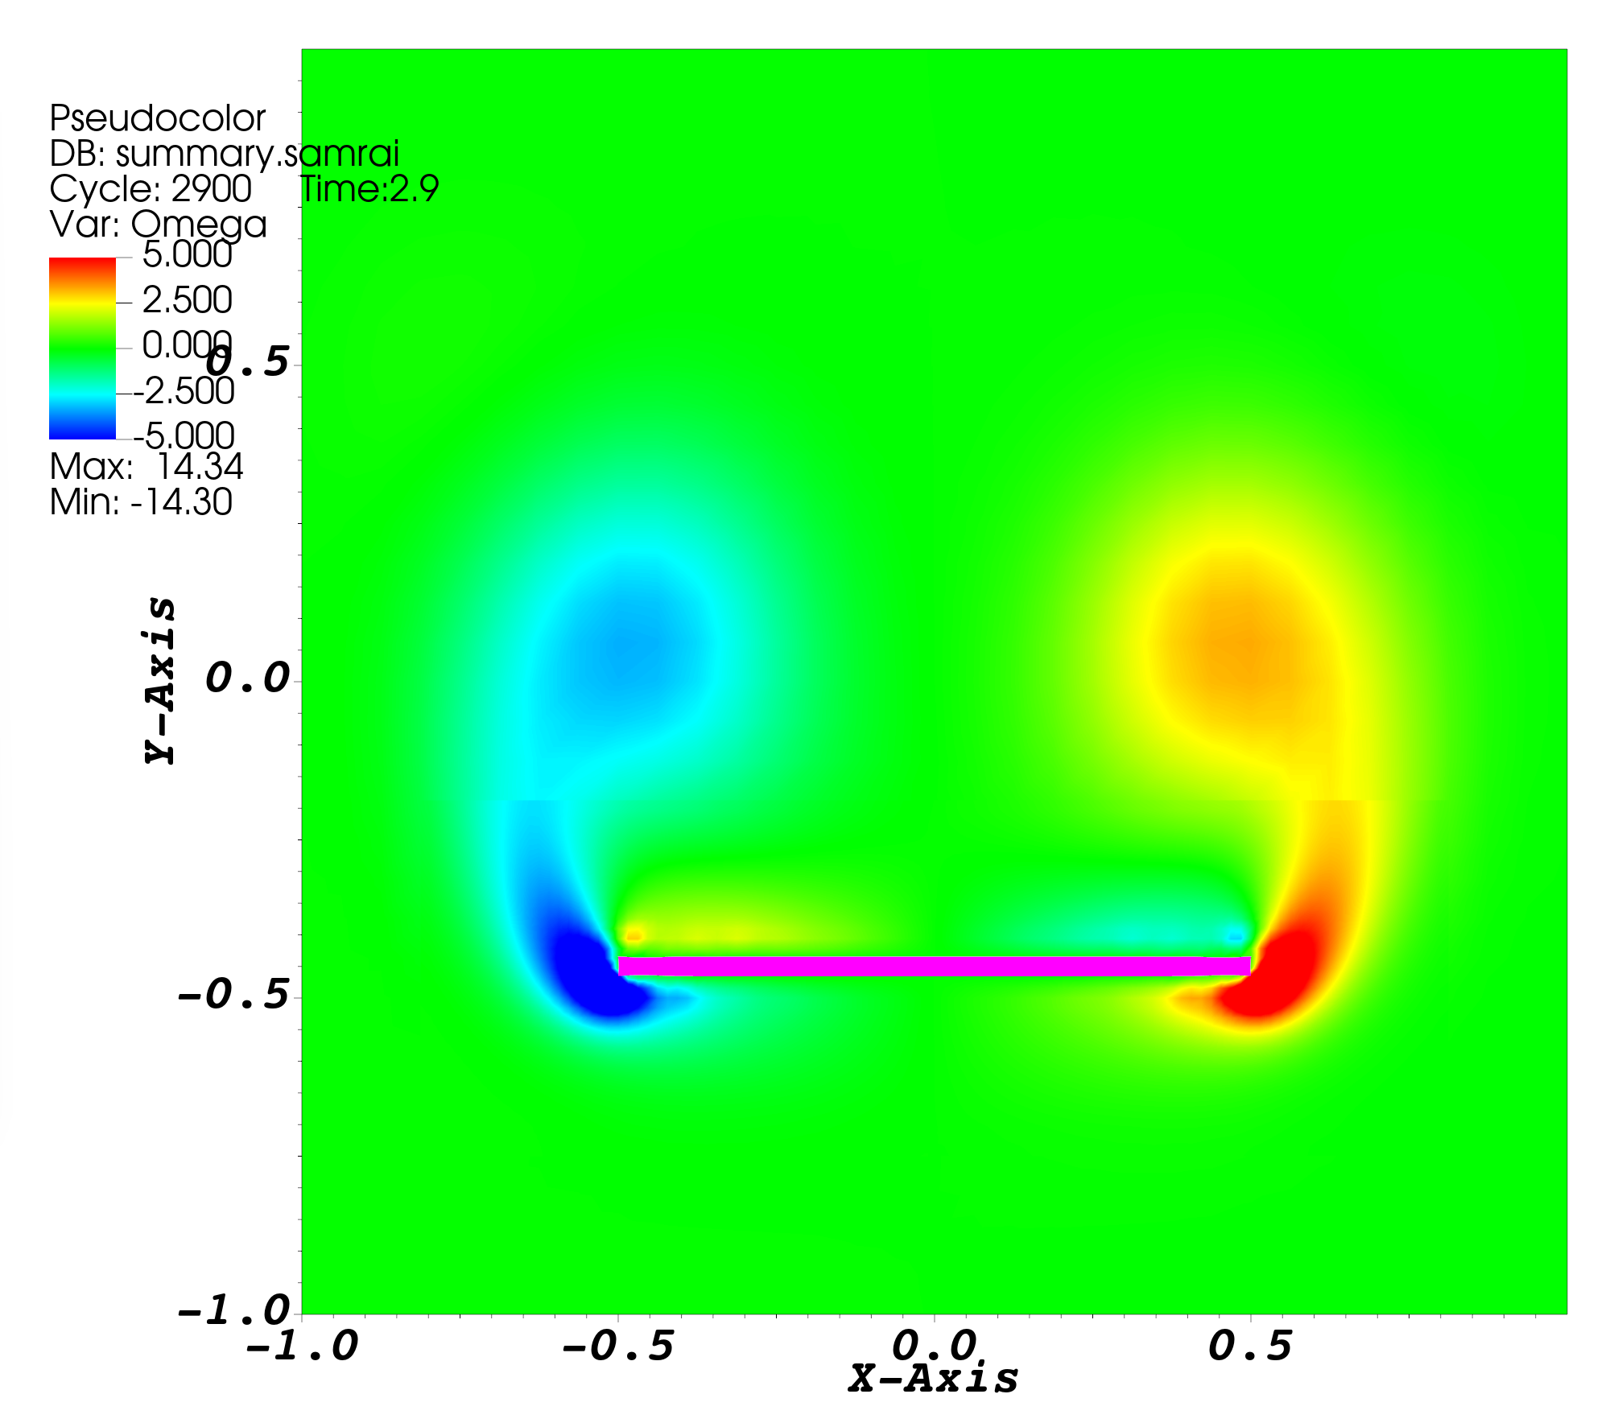
Example_IBFE_TetherForceFullPlate2D

Slide 13
Apply the force only on the right half of plate
Note the center of the plate is the origin. s(0)>0.0 denotes the right side.
If statement only applies force on right side of plate.
if(s(0)>0.0){
libMesh::Point s_dump; //s_dump is the target point position
if(time<1.0) //This will move the beam up with a speed of 0.5 from 0<t<1
{
s_dump(1)=s(1)+0.5*time; //only change the y-coordinate. s(1) is the x-coordinate of the reference
s_dump(0)=s(0); //s(0) is the x-coordinate of the reference configuration
}
else if(time<3.0) //This will move the beam down with a speed of -0.5 for 1<t<3
{
s_dump(1)=s(1)+0.5+0.5*(1.0-time);
s_dump(0)=s(0);
}
else //set the target point location to the actual location of the boundary (X) to make force equal to zero.
{
s_dump(1)=X(1);
s_dump(0)=X(0);
}
F = kappa_s*(s_dump-X); //apply a target force equal to kappa_s times the difference between tether and actual positions.
}
else{
F.zero();
}
return;
}

Slide 14
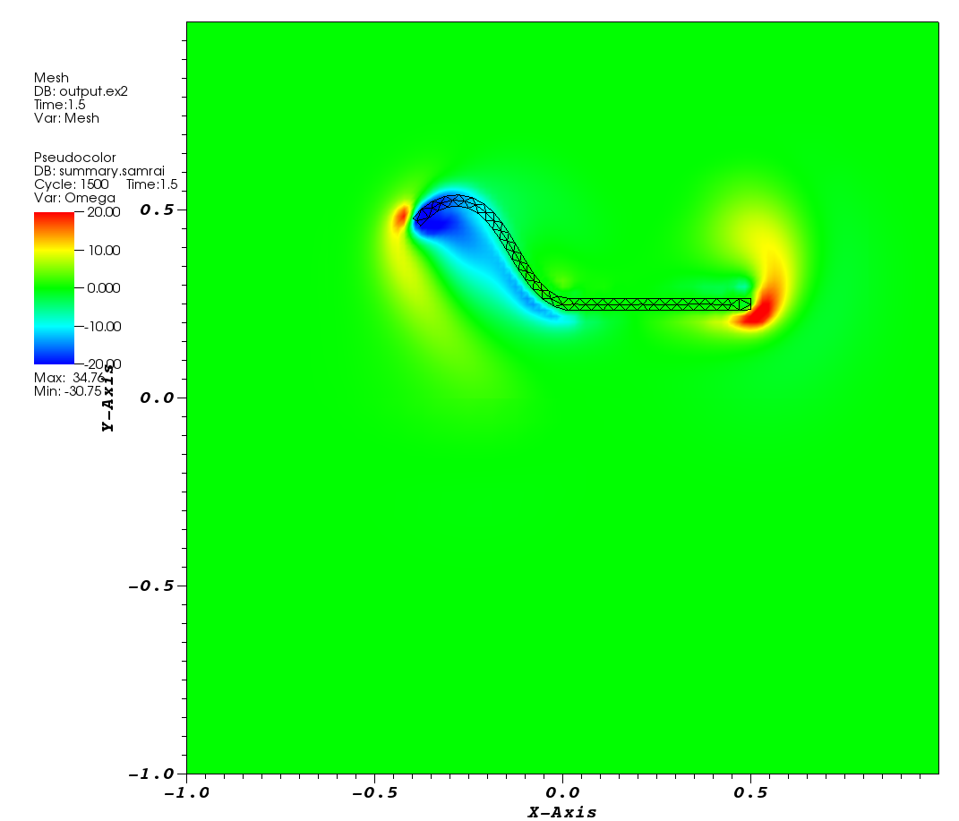
1-IBFE-Example_TetherForceHalfPlate2D
Again using a body force acting as tether force defined in the ModelData namespace, I now have a have half the plate of move up to .5 (in 1 s) then down 1.0 (in 2s), after which I turn off the force (for 1 s). The movement of the other half of the plate is purely passive (i.e. PK1 Stress)

Slide 15
The goal here is to spin the beam about its center for t<1, and then release it.
Code to rotate the plate
if(time<1)
{
s_dump(1)=s(1)+s(0)*sin(2*3.14*0.5*time); //y-coordinate gets moved more the farther along the beam you are, We should really define PI better here
s_dump(0)=s(0)*cos(2*3.14*0.5*time); //adjustment for x-coordinate along the length
}
else //turns off all forcing, target coordinates set to current coordinates
{
s_dump(1)=X(1);
s_dump(0)=X(0);
}
F = kappa_s*(s_dump-X);
return;
}

Slide 16
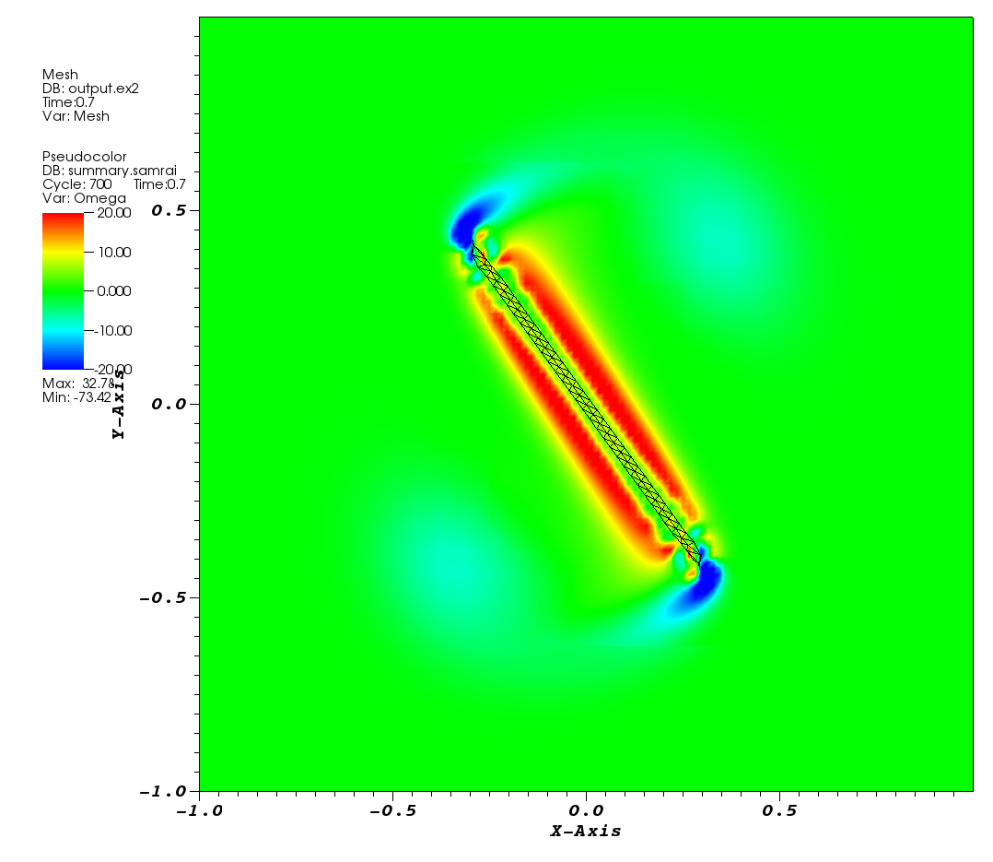
1-IBFE-Example_TetherForceFullPlate2D-Rotate
The goal here is to spin the beam about its center for t<1, and then release it.

Slide 17
Reading your mesh
This happens in the main.C file. For example:
Mesh mesh(init.comm(), NDIM);
const double dx = input_db->getDouble("DX");
const double ds = input_db->getDouble("MFAC")*dx;
string elem_type = input_db->getString("ELEM_TYPE");
mesh.read("IBFE_Mesh2D_128.mat");
mesh.prepare_for_use();
Look at the README files in the examples.

Slide 18
Visualizing the FE Mesh

Slide 19
Please also see the youtube tutorial from Shannon Jones here:
https://www.youtube.com/watch?v=Kj_MACemSd0

Slide 20
File Formats
dumps.visit – Eulerian data
output.ex2 – Finite Element/Lagrangian data
Exodus II type file
Can have multiple files of this type for different parts of object

Slide 21
Open dump.visit and output.ex2 in VisIt
In the left hand corner, unclick the “Apply operators to all plots” option
Under active source, choose the output.ex2
Load mesh (but don’t Draw)

Slide 22
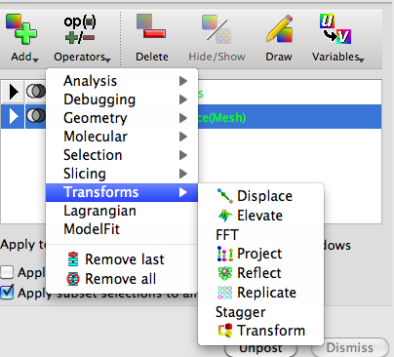

Load mesh (but don’t Draw)
Highlight the mesh and go to Operators>Transforms>Displace
Collapse the Mesh option and double-click on the Displace option

Slide 23
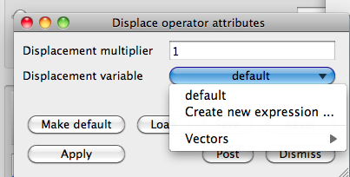
Under the options for the ‘Displacement variable’, go to ‘Create New Expression’
In the new window, change the Type to ‘Vector Mesh Variable’ (and also change the name of the new variable to ‘dX’)

Slide 24
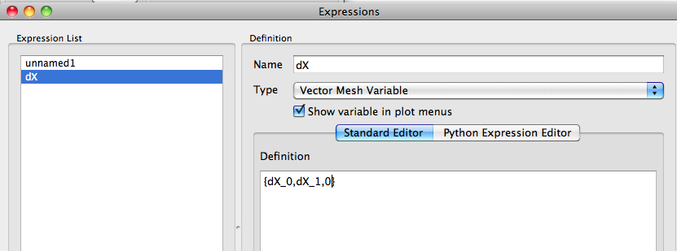
In the ‘Definition’ section, write ‘{dX_0,dX_1,0}’ if 2D and ‘{dX_0,dX_1,dX_2}’ if 3D.
Note: For new ibamr install in 2D, use {dX_0,dX_1}
At this point I would save this variable as an XML file because you will need to do this every time. Hit ‘Apply’ on the ‘Expressions’ window and close it.

Slide 25
Now change the Displacement variable option to Vectors>dX. Hit Apply and close the menu. This allows changes from the reference configuration.
Add whatever other variable you want (for instance Omega)
You may not need to do the steps below with new ibamr module (if you displace using {dX_0, dX_1}).
Remember, the Finite Element mesh is in 3D and the Eulerian variables are all in 2D so we will need to project the mesh to 2D.
Highlight the mesh and click Operators>Transforms>Project
The default projections should be for the xy-plane(which is what we want), but you can change this if you want if you double click Project in the collapsed menu from the Mesh Object.
Draw!

Slide 26
Boyce’s examples List
ex0: Rubber band
ex1: Stretched rubber band
ex2: Cavity flow with mesh at bottom
ex3: Cavity flow with mesh at bottom
ex4: Cavity flow with deformable ball
ex5: Flow past cylinder
ex6: Flow past beam and block (square with long rectangular tail)

